Slide 1
Predicting Housing Prices
By John David Thompson

Slide 2

Research Questions
What factors influence housing prices?
How well can machine learning predict housing prices?
Which model preforms better (Linear Regression or Random Forest Regression)

Slide 3

The dataset
California Housing Prices 1990 Census Data
Median Income, Number of Rooms, and Proximity to the Ocean

Slide 4

Data Preparation
Removed all missing values
Created new columns

Slide 5
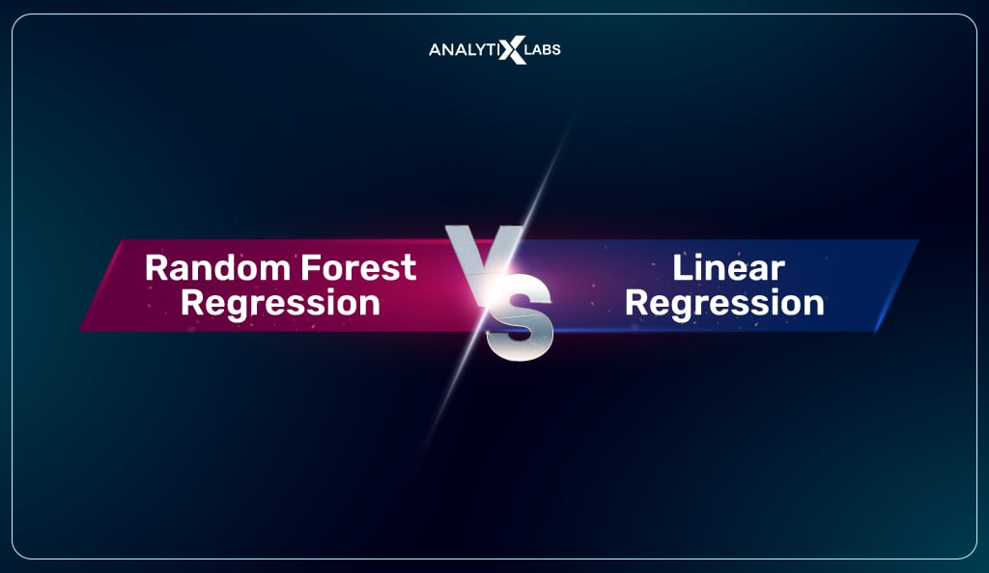
Machine Learning models
Linear Regression Model
Random Forest Regression Model

Slide 6
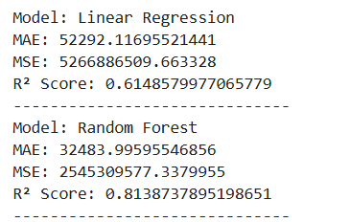
Model Comparison
Performance metrics (MAE, MSE, R²)

Slide 7
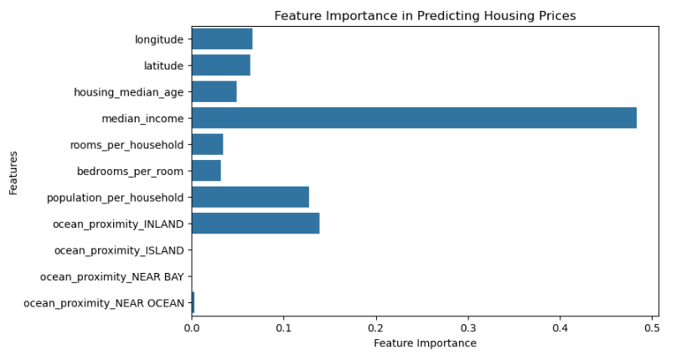
Feature importance

Slide 8
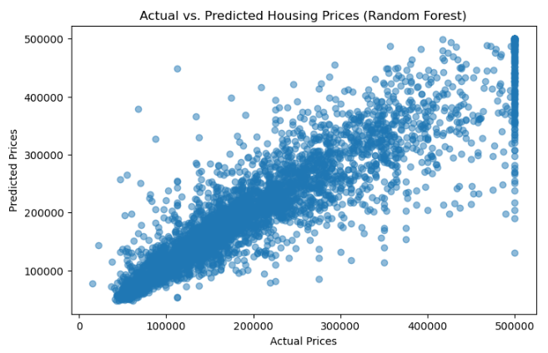
Actual vs predicted

Slide 9

Summary
Random Forest Testing proved to be the more accurate model
Median Income most important factor

